Slide 1
COVID-19 United States Metrics
Marquis Sills, Bryce Deering, Anna Reed, and Zalak Gajjar

Slide 2
Project Overview
The primary objective is to provide visualizations of data related to COVID-19 throughout the United States at the state level.
We will display information pertaining to different metrics related to COVID-19 for each state. Metrics will include confirmed cases, deaths, and case fatality ratio (Number recorded deaths / Number cases).
Finally, we will look at this data from a regional standpoint to note any correlations.
Notes:
Marquis

Slide 3

Covid Data Source
Notes:
Marquis

Slide 4
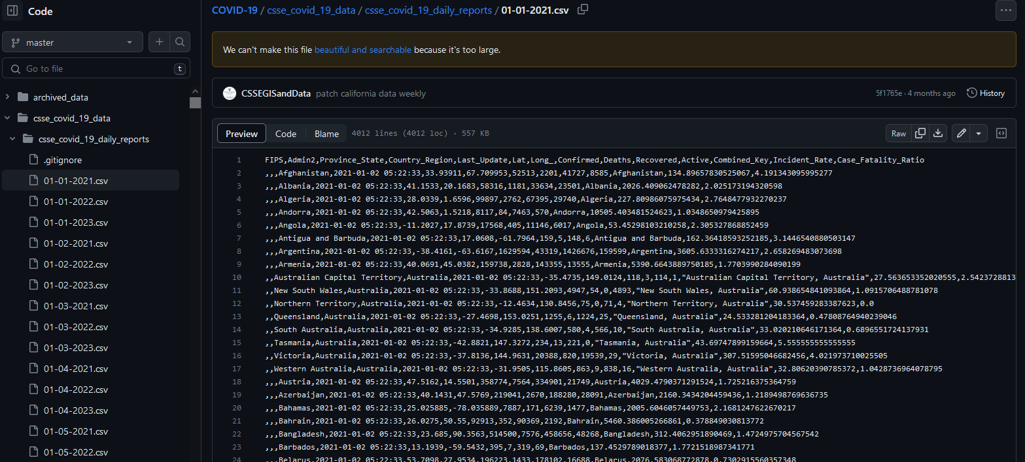
Notes:
Marquis

Slide 5

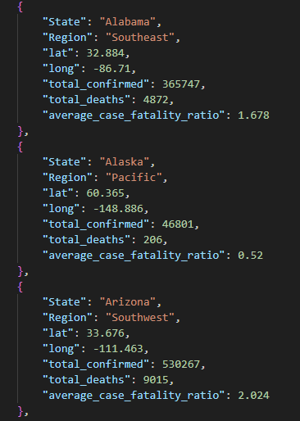
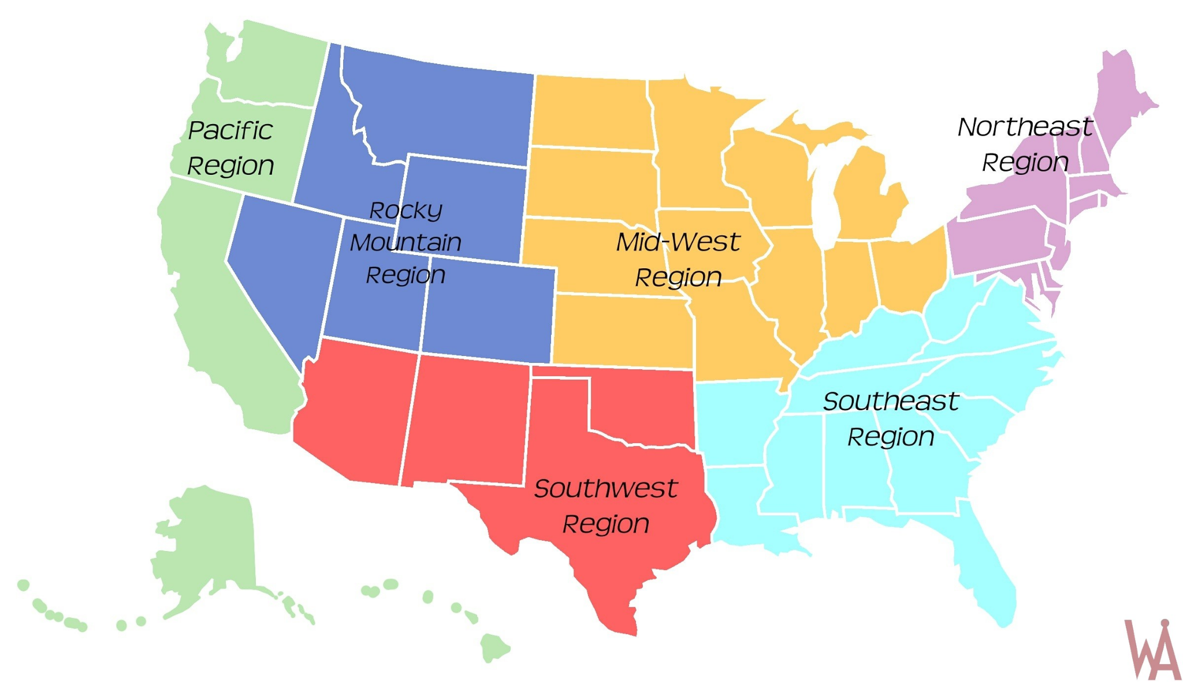
Notes:
Marquis

Slide 6
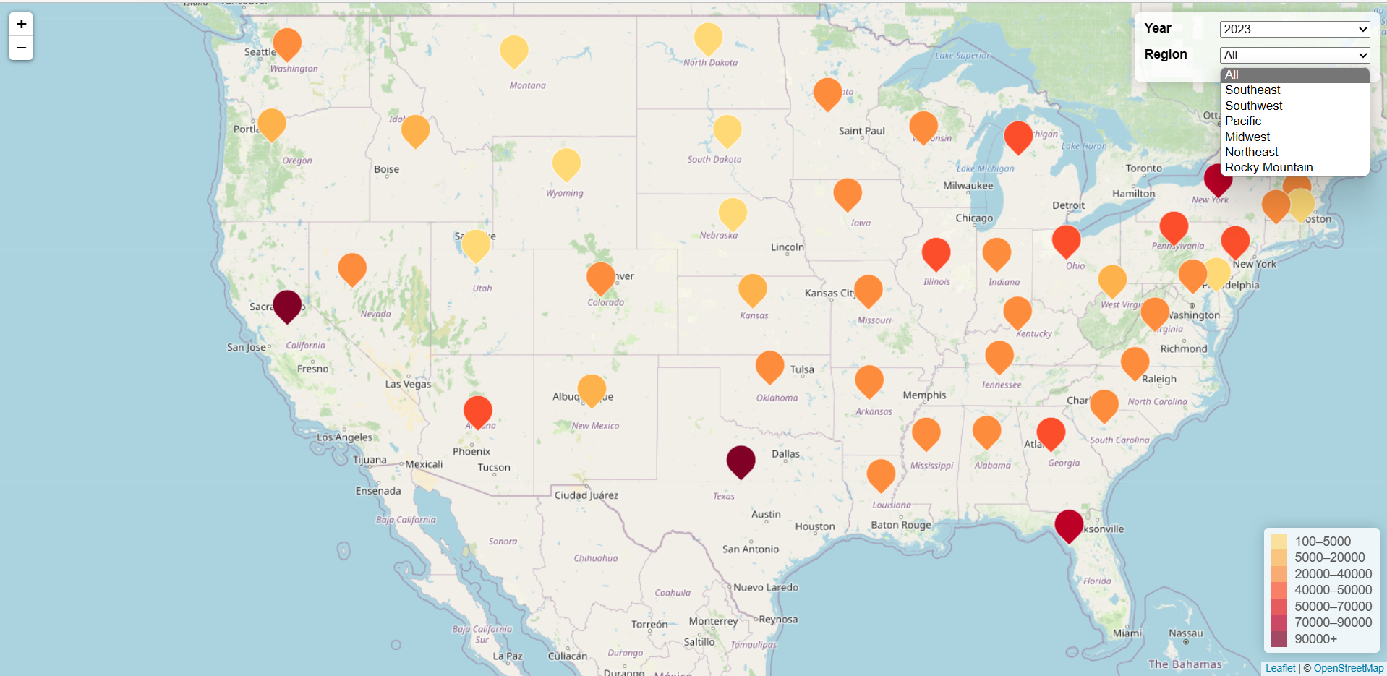
Website Presentation
Notes:
Zalak

Slide 7
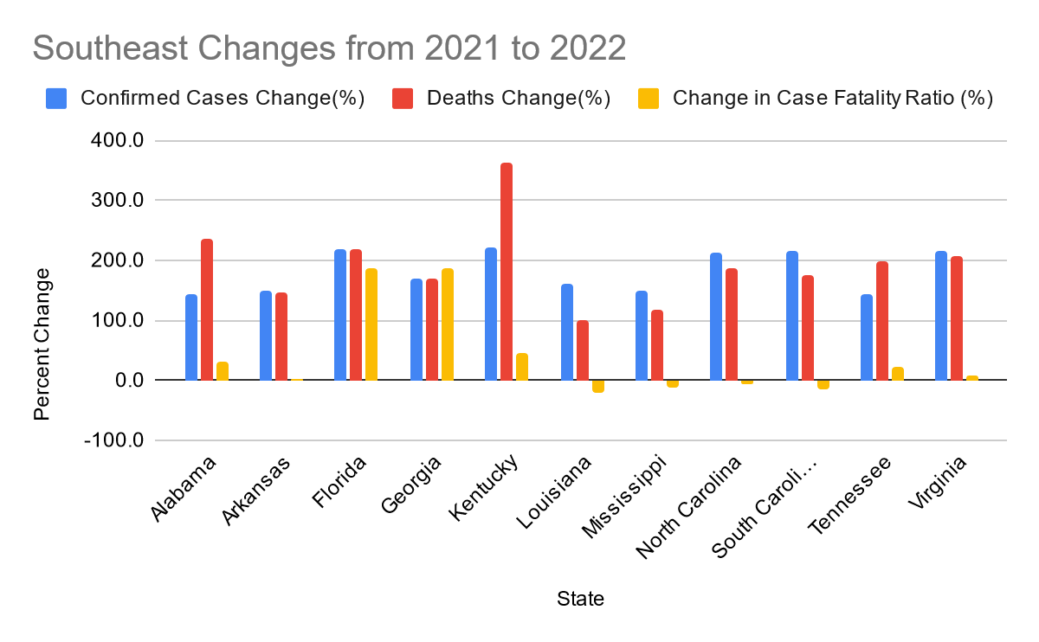
2021-2022 State Changes
Notes:
Anna

Slide 8
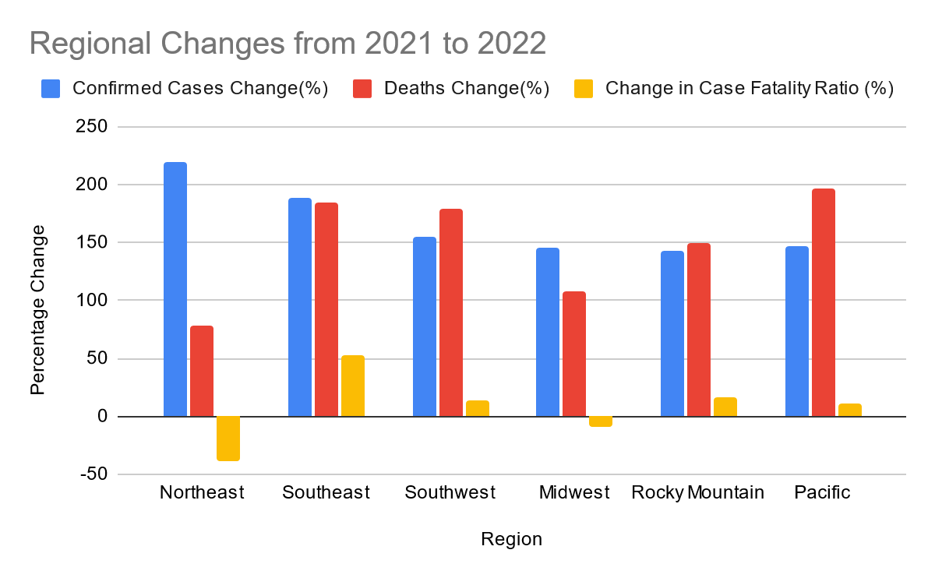
2021-2022 Regional Changes
Notes:
Anna

Slide 9
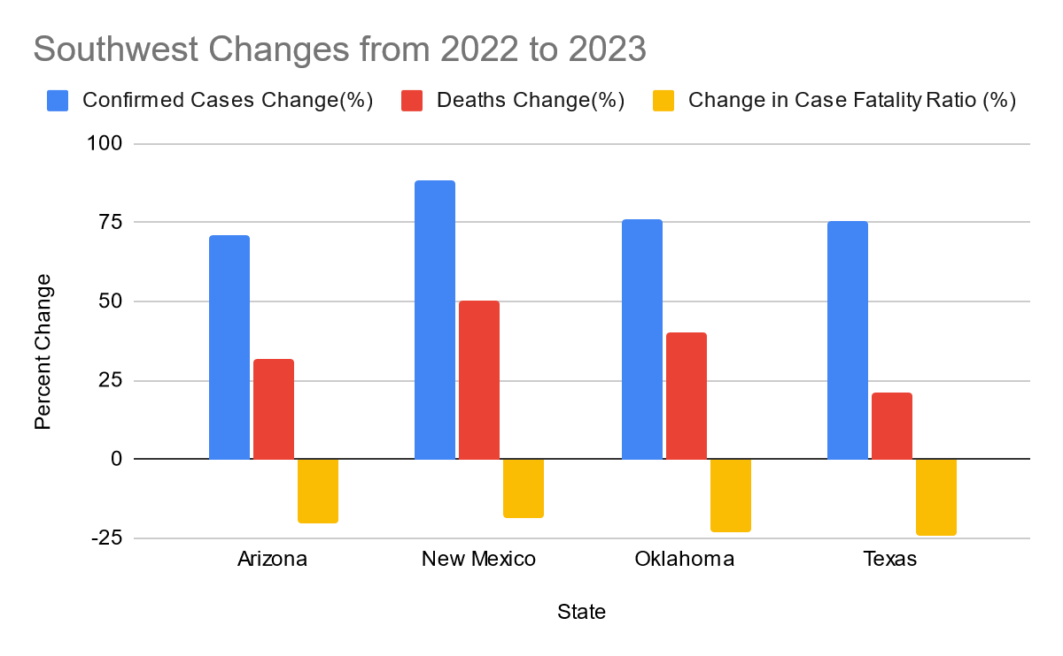
2022-2023 State Changes
Notes:
Bryce
2022-2023 State Changes Southwest
This analysis provides an overview of the COVID-19 impact on Southwest states between 2022 and 2023, emphasizing the changes of confirmed cases, deaths, and the change in the case fatality ratio.
While New Mexico had the highest increases in confirmed cases (83.3%) and deaths (50.5%), it also had a substantial decrease in the case fatality ratio (decrease of 18.7%).
Oklahoma and Texas both exhibited improvements in the case fatality ratio, with decreases of -23.04% and -24.1% respectively, indicating effective management of severe cases.
These findings highlight the importance of monitoring and adapting strategies to combat the ongoing pandemic effectively.

Slide 10
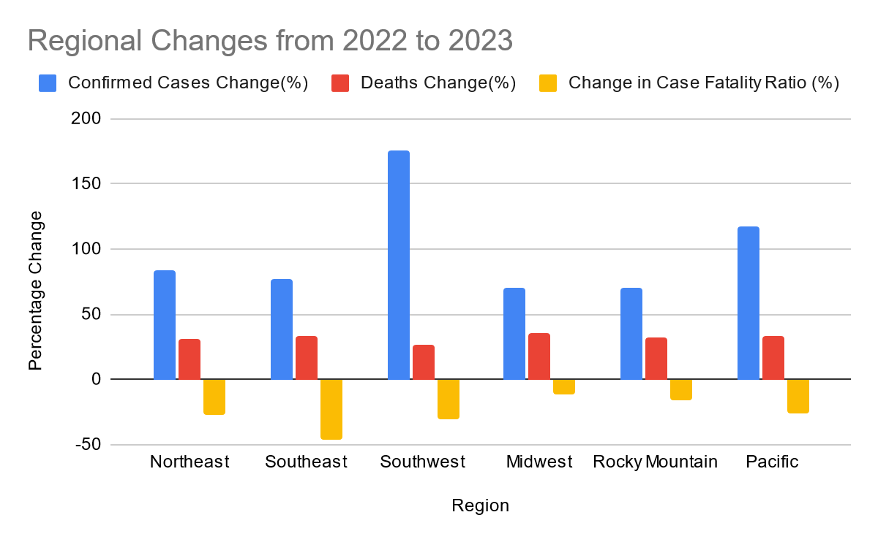
2022-2023 Regional Changes
Notes:
Bryce
2022-2023 Regional Changes
This bar chart provides an overview of the COVID-19 impact at the regional level throughout the United States between 2022 and 2023, emphasizing the changes of confirmed cases, deaths, and the change in the case fatality ratio.
The Southwest region experienced the highest increase in confirmed cases (175.35%), indicating a significant surge in COVID-19 infections, necessitating urgent measures to control the spread.
The Southeast region had a higher increase in deaths (33.74%), emphasizing the need for enhanced healthcare strategies to reduce mortality rates and ensure access to critical care facilities.
The Southeast region exhibited the largest decrease in the case fatality ratio (-46.38%), indicating substantial progress in managing severe cases and potentially improved healthcare interventions.
Regional variations in the case fatality ratio, such as decreases in the Northeast, Pacific, Midwest, and Rocky Mountain regions, highlight the importance of tailored approaches and region-specific measures in mitigating the impact of COVID-19.

Slide 11
Questions?

